Slide 2
EBP A

Slide 3
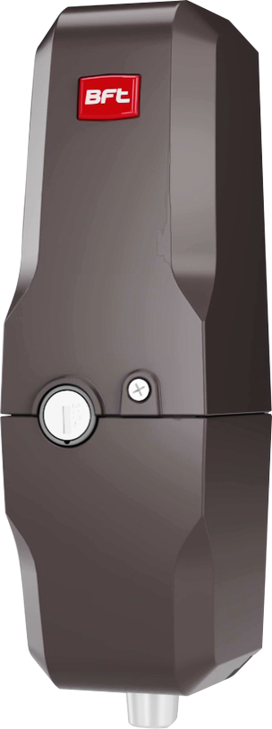
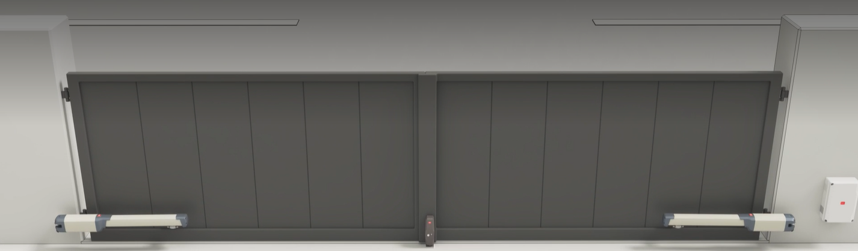
EBP A: Main Features
What to
know
1
Flexibility
Suitable for inward and outward opening gates
4
New EBP 24V
Perfect for low voltage automations, with its direct connection to the control unit, without the use of transformers or additional electronic boards
Supplied with ground plate
with hole for the bolt (the ground plate of the EBP does not act as a vertical stop for closing the gate)
5
2
New look
Based on BFTs modern style, for a great integration into the installation context
100% compatible with the previous version of EBP
including models with key release also from outside (EBPE)
6
3
Range rationalization
No longer specific models of EBP with both internal and external release: the key lock for unlocking from the outside is supplied as an accessory, and can be installed on the new EBP A at any time
Specific key locks available on request
to have just one key for unlocking the operators and the electric lock, and for the selector. The key number is printed on the electric lock packaging for quick identification
7

Slide 4
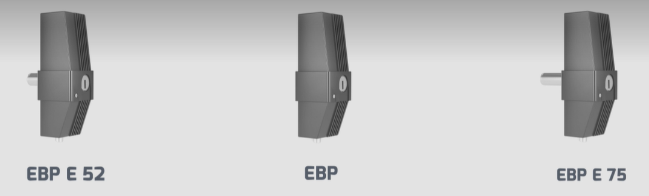
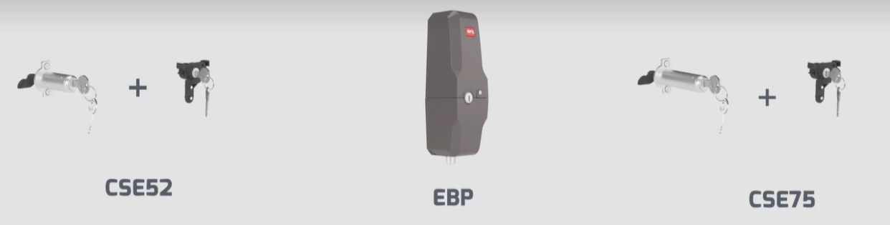
EBP A: Accessories
What to
know
The previous models of electric lock with external release - EBPE - are replaced by the accessories CSE52 (external key lock for gates up to 50mm thick) and CSE75 (external lock for gates up to 75mm thick)
Each external key lock is also supplied with an internal one, in the way to have the same key for both the external and internal locks
The installer who intends to fit the external key lock must also replace the internal key block, to avoid having 2 different keys for the same electric lock (one for the inside and one for the outside)
BEFORE
EBP
EBPE 52
EBPE 75
NOW
EBP A
EBP A
EBP A
CSE 52
CSE 75

Slide 5
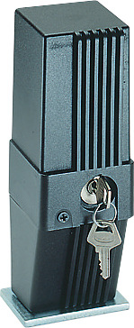
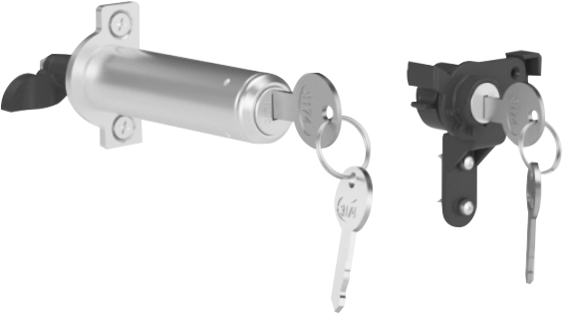
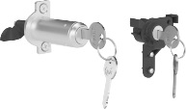

Plus & Benefits
What to
say
It is no longer necessary to have all models available; all that is needed is the electric lock of the required voltage (230V or 24V) and the accessories
Directly at the installation site, depending on the gate and the agreements with the end user, the installer can decide whether to install the electric lock with release only from the inside, or also from the outside and in the size required by the gate, simply by mounting the accessory on the product
      Range optimization: 1 model of the new EBP A + 2 accessories = 3 models of the old EBP
EBP AC A 230V
EBP 230V
EBPE 52 230V
EBPE 75 230V
EBP AC A 120V
How to
say
EBP BT A 24V
EBP24 + TRASF.230/24V
EBPE 24 52 +TRASF.230/24V
EBPE 24 75 ELETTROC.+TRASF.230/24V
EBP 120V

Slide 6
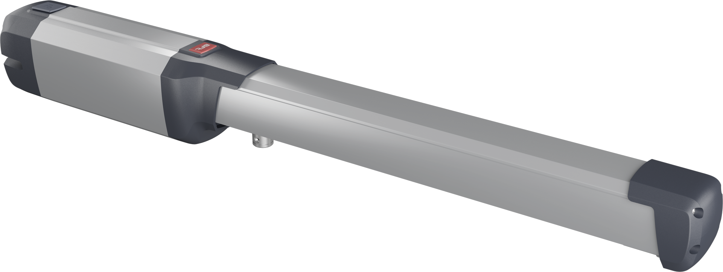

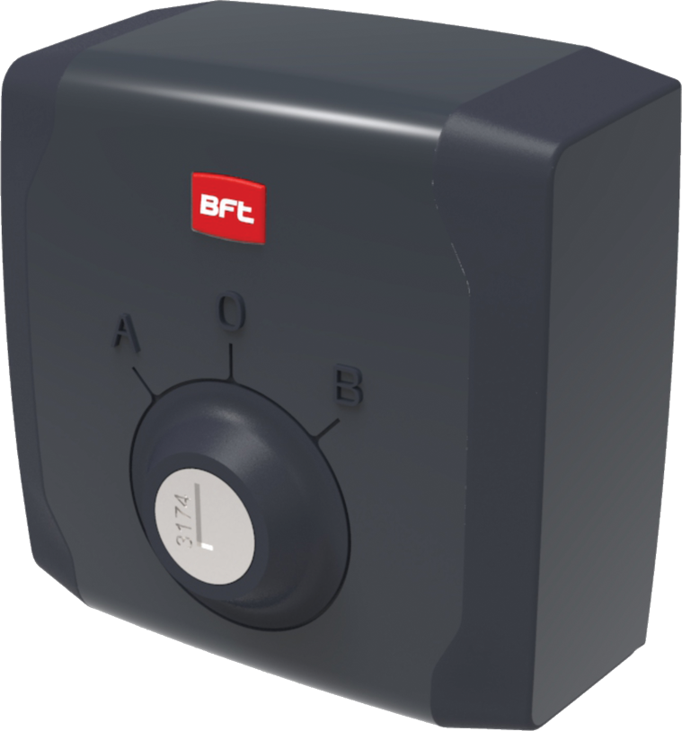



Plus & Benefits
What to
say
At any time, the key-lock cylinder of the new EBP A can be replaced with one matched to a specific key number, so that the same key can be used to unlock the operators and the electric lock, and activate the selector switch
This can also be done if the new EBP A is fitted with the external key cylinder CSE52 or CSE75
In fact, both CSE accessories include both internal and external key cylinders and can be ordered by requesting a specific key number
        A single key to unlock the operators and the electric lock, and activate the selector switch
How to
say

Slide 7




Plus & Benefits
What to
say
Old EBP models can be replaced with new ones without having to carry out any adaptation work on the gate: all holes for fixing screws and cable passage remain in the same positions
EBPE models, with the key release on the outside of the gate, can also be replaced with the new EBP A, to which the CSE52 or CSE75 accessory must be added. In this case too, no additional adjustment work is required on the gate
      The new EBP A is 100% compatible with the previous EBP version, for simple and fast replacement
How to
say

